Slide 1
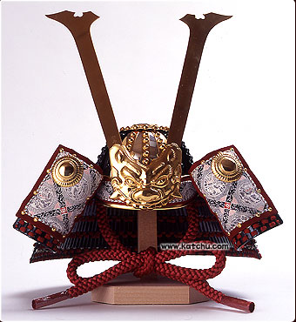
Hirotaka Nakayama
Konan University
Dept. Info. Sci. & Sys. Eng.
Inter’l MCDM Summer School 2006, Taiwan
Kainan University
（開南大学）
（中山 弘隆）
(甲南大学)
1) Aspiration Level Approach to Interactive Multi-objective Programming
2) DEA (GDEA) & Generation of Pareto Frontier
3) Support Vector Machines based on MOP/GP
4) Approximate (Multi-objective) Optimization using SVM(SVR)

Slide 2
Aspiration Level Methods in Interactive Multi-objective Programming and their Engineering Applications
Hirotaka Nakayama
Dept. of Info. Sci. & Sys. Eng.
Konan University
E-mail: nakayama@konan-u.ac.jp

Slide 3
Multiple Criteria Decision Making
want to make
this criterion better
And others too.
・
・

Slide 4
Multiple Criteria Decision Making
Making this
criterion
better
Another one
becomes worse
・
・

Slide 5
Multiple Criteria Decision Making
How much do we
make this better?
How much do we
sacrifice another one?
・
・
Trade-off Analysis

Slide 6
Trade-off Analysis
Value Judgment

Slide 7
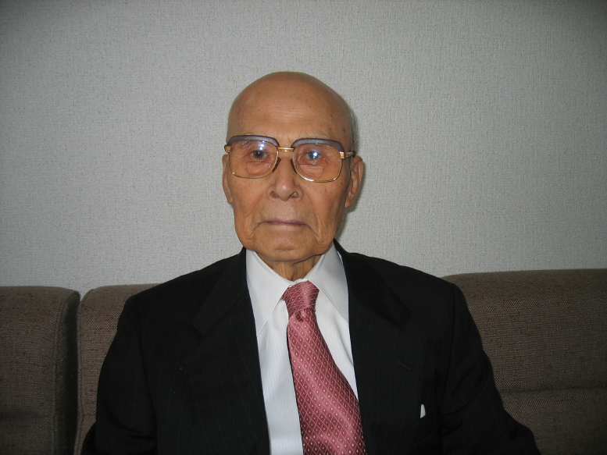
Difficulties in Value Judgment
Multiplicity
Balancing among many objectives
Inconsistency
Prof. Sawaragi
Sawaragi, Nakayama, Tanino:
Theory of Multi-objective
Optimization,
Academic Press (1985)
DM said something yesterday, but another thing today.
君子豹変
This situation is usual (reasonable)
because information available changes over time.

Slide 8
How should we incorporate
value judgment into DSS?
Main theme of MCDM

Slide 9
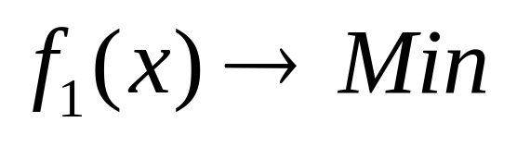
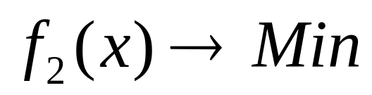

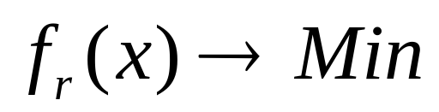
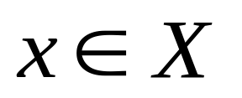
Multi-objective Programming
subj. to

Slide 10
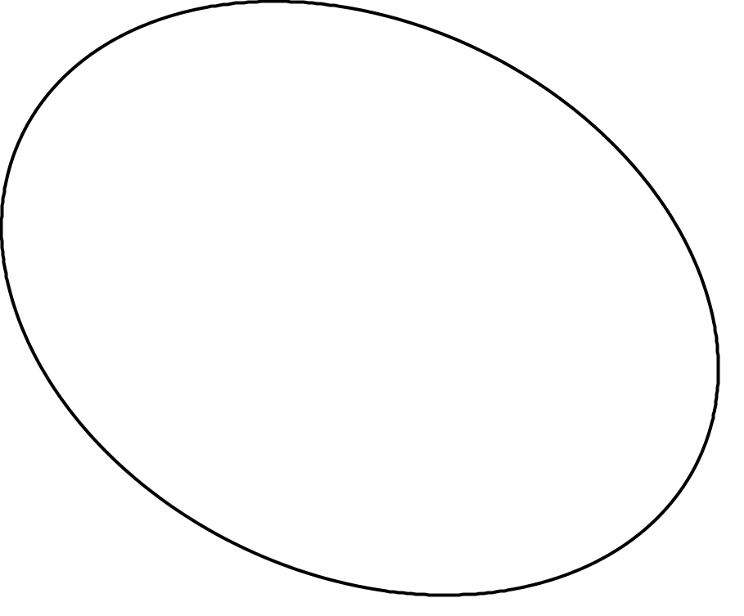
Pareto Solution and Efficient Frontier
f2
A
B
f1

Slide 11
Pareto Solution and Efficient Frontier
f2
B
f1

Slide 12
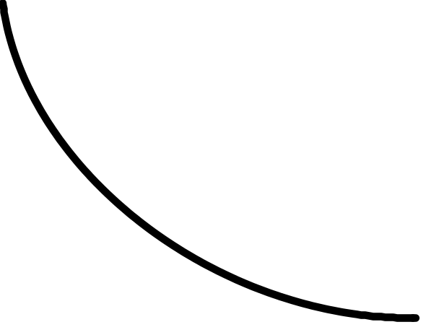
Pareto Solution and Efficient Frontier
f2
Pareto frontier
(efficient)
f1

Slide 13



Trade-off Analysis based on Pareto Frontier
..\..\..\..\..\MATLAB(BEAM)\beam1.fig
2-dimensional case
3-dimensional case

Slide 14
Finding Pareto Solutions
Scalarization
Constraint transformation
Edgeworth : Mathematical Psychics, 1881

Slide 15

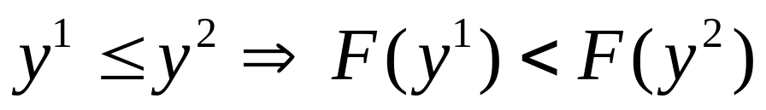
Scalarization function
Theorem Let y be a vector of the objective space. Suppose that is order preserving
i.e.,
then the solution minimizing is a Pareto solution.
How about the converse?

Slide 16
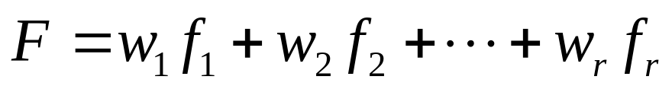
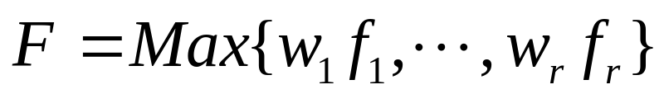
Examples of Scalarization Function
linearly weighted sum
Tchebyshev type (>- monotonous)
augmented Tchebyshev type

Slide 17
Linearly Weighted Sum

Slide 18
Tchebyshev type
weak Pareto solution

Slide 19
Augmented Tchebyshev type

Slide 20


Augmented Tchebyshev Scalarization Function
Theorem (Nakayama-Tanino 1994)
For any and , the solution minimizing the augmented Tchebyshev scalarinzation function is a proper Pareto solution.
Conversely, any proper Pareto solution can be obtained by minimizing the augmented Tchebyshev scalarization function with some appropriately chosen , and an aspiration level. .

Slide 21



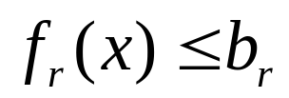


Constraint transformation
subj. to

Slide 22
In cases with more than three objective functions
Interactive Programming Method
Eliciting preference information of DM, the solution is searched.
local trade-off
What should be used as information reflecting DM’s preference?

Slide 23
Weighting method does work.
Many people say
We can obtain a desirable solution by adjusting the weights.
……….?
No!

Slide 24



English
100
B
C
45
A
5
50
90
Math

Slide 25
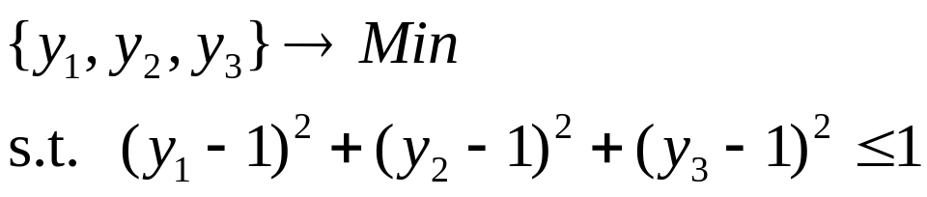


Example
want to improve much more
want to improve a little
worse than before
No normalization of weights?
still worse than before!

Slide 26
Why does not the weighting method work so well?
No positive correlation between weights in linear scalarization function and resulting solution.
Weights are not appropriate as “information” reflecting DM’s preference.
aspiration level approach

Slide 27
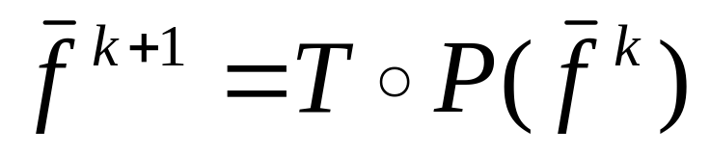

Satisficing Trade-off Method
(Nakayama 1984)
Operator Ｐ： the nearest Pareto solution to the given
aspiration level
Operator T： trade-off analysis（How much can we agree
to relax other criteria in order to improve
some criteria)

Slide 28





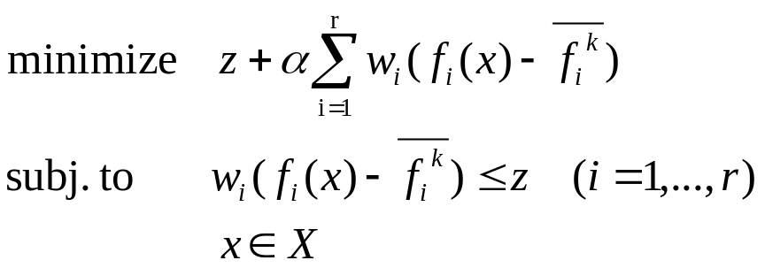
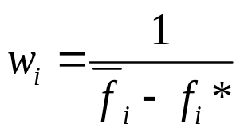
Satisficing trade-off method
●
○
●
○
1. Set the ideal pt.
●
2. Set the aspiration level
3. Show the nearest Pareto solution to the given aspiration level by
solving the following auxiliary problem:
4. Agree with the shown Pareto solution stop.
Not agree trade-off analysis

Slide 29
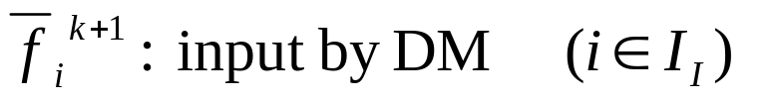

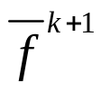
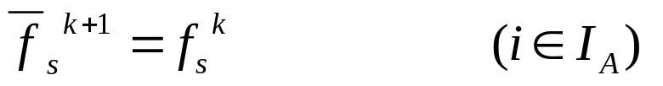
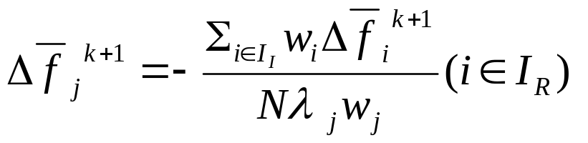

Easy trade-off analysis (1)
Automatic trade-off

Slide 30


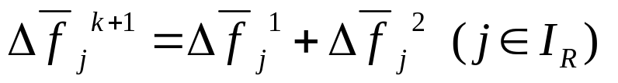
Easy Trade-off Analysis (2)
Exact Trade-off

Slide 31
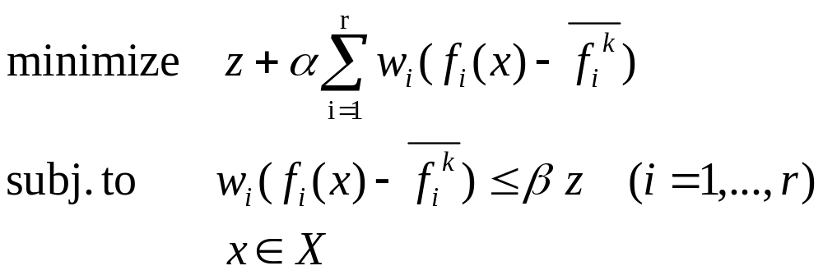



Exchange of Objectives and Constraints
(Korhonen 1987)
: objective
: constraint

Slide 32





Satisficing trade-off method
Ex.
1)
want to improve much more
want to improve a little
2)
Much better than before
A little better than before
Automatic trade-off

Slide 33
Engineering Applications by MOP Methods
W. Stadler (ed.)
Multicriteria Optimization in Engineering and in the Sciences,
Plenum 1988
M. T. Tabucanon:
Multiple Criteria Decision Making in Industry, Elsevier 1988
H. Eschenauer, J. Koski and A. Osyczka (eds.)
Multicriteria Design Optimization, Springer 1990
R. B. Statnikov:
Multicriteria Design, Kluwer 1999

Slide 34
Applications
of Satisficing Trade-off Method
・ construction accuracy control of cable stayed-bridges
・ feed formulation of live stocks
・ bond portfolio
・ blending raw materials in cement production
・ scheduling of string selection in steel manufacturing
・ medical irradiation planning
・ water supply planning in local governments
・ lens design

Slide 35
Decision Process = Learning Process
・ simple （簡単）
・ easy （容易）
・ fast （速い）
MCDM
needs easily to obtain a solution as DM desires.
→ How to incorporate the value judgment of DM
into the decision support system
Aspiration level rather than weights!

Slide 36
Satisficing Trade-off Method
Optimal satisficing (aspiration level approach)
human beings: global judgment (aspiration level) ← satisficing
computer: optimization based on the augmented Tchebyshev
functions
Sharing roles
among human beings and computer

Slide 37

DSS for MCDM
human beings
computers
・roughly but rapidly making global judgment
・precisely making a large number of calculation
・intuitive
・logical
Making full use of strong points
of human beings and computers respectively

Slide 38
Generating Pareto Frontiers
K. Deb:
Multi-objective Optimization using Evolutionary Algorithms, Wiley 2001
C.A. Coello Coello, D.A.Van Veldhuizen, G.B. Lamont :
Evolutionary Algorithms for Solving Multi-
objective Problems, Kluwer 2002

Slide 39
Evolutionary Algorithms
VEGA (Vector Evaluated Genetic Algorithm) Schaffer (1984)
MOGA (Multiple Objective Genetic Algorithm) Fonseca-Fleming (1993)
NSGA (Non-Dominated Sorting Genetic Algorithm) Srinivas-Deb (1994)
NPGA (Niched Pareto Genetic Algorithm) Horn-Nafploitis-Goldberg (1994)
SPEA (Strength Pareto Evolutionary Algorithm) Zitzler-Thiele (1998)

Slide 40
Fitness of individuals
Convergence
How close is each individual to Pareto frontier?
ranking method, …
Diversity
How much does the population spread over the whole Pareto frontier?
sharing function, …

Slide 41
Convergence by Ranking
f₂
Usually need many number of populations to attain a good approximation of Pareto frontier.
● E
(6)
Rank does not reflect “distance” between each individual and Pareto frontier.
● A
(1)
● C
(1)
● F
(3)
● D
(1)
● G
(2)
● B
(1)
● H
(1)
f₁
Notes:
まず、ランキング法です。
GoldbergやFoncecaらによって提案されたこの方法は、幅広いところで使用されています。
例えば、この青い線が真のパレートプロンティアであり、個体がAからGまであるとします。
すると、各個体のランクはこのようになりますが、
これらの数字は自分より優越しているものが何個あるかを表しています。
ここで、個体D、F、Gに注目していただきたいと思います。
パレートプロンティアからより遠くにあるGのランクは、 Fのランクより高くなっています。
しかも、ほんの少しで差で、DとFとの間には２つのランク差があります。
ランキング法では、このような現象が起こりやすく、
そのため、遺伝的アルゴリズムの計算では、長い世代数が必要となります。
そこで、

Slide 42
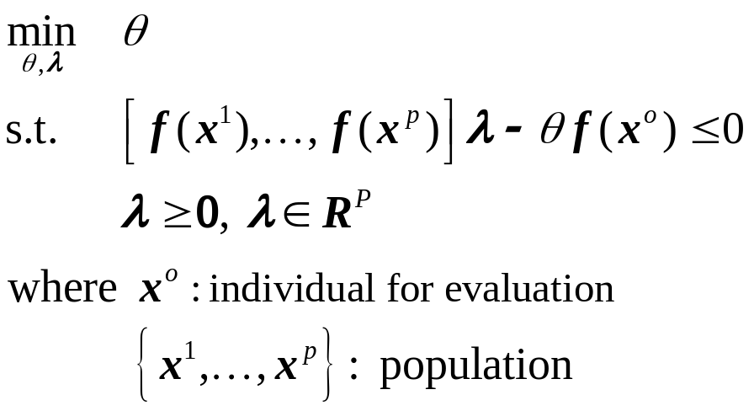



Using Data Envelopment Analysis
Arakawa, Nakayama, Hagiwara, Yamakawa
  （Multiobjective optimization using adaptive range genetic
  algorithms with data envelopment analysis, AIAA, 1998）
better evaluation of “distance” between each individual and Pareto frontier.
However, available only for convex cases.
● A
● E
● C
R
● F
f₂
● D
● G
P
Q
● B
● H
f₁
Convex hull
(envelope by hyperplane)
O
Notes:
荒川先生らにより、DEAを用いる方法が提案されました。
先ほどと同じ例題で説明いたしますと、
まず、個体を包むこのような点線を考えます。
すると、点線の上にあるAやB、Hの評価値は１であり、他の個体に対しては、このようになります。
例えば、Gの評価値は、OG分のOQ、ここでQは原点とGを結ぶ線が点線とあうところです。
点線から近いほど、評価値は高く、離れていくほど、低くなります。
つまり、DEAによる方法では、真のパレートプロンティアを近似したこの点線から、
どれだけ離れているかの定量的評価を行うため、
より早く、より正確に真のパレートプロンティアに近づくことができます。
これらの評価値は、この問題を解くことで求めることが出来ます。

Slide 43
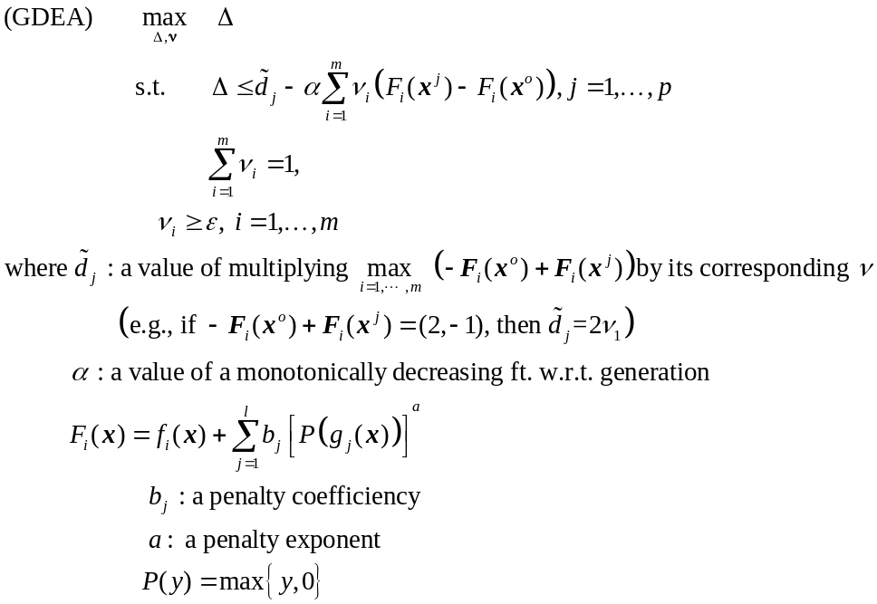
Using Generalized DEA
Yun, Nakayama, Tanino, Arakawa
  Generation of efficient frontiers in multi-objective
  optimization problems by generalized data envelopment
  analysis, EJOR, Vol.129, No. 3, pp. 586-595 (2001)
Available for non-convex cases.
Envelopment is based on convex cones instead of hyperplane.
Notes:
次に、紹介する方法はGDEAによる方法です。
DEAによる方法を非凸問題にも適用可能にしたものですが、
与えられたαに対するこの問題によって、各個体は評価されます。
αの役割について説明いたしますと、

Slide 44
Engineering Applications
Function forms of many criteria are not given explicitly in terms of design variables.
….. are evaluated via analyses (structural analysis, fluid mechanical analysis, thermo-dynamical analysis, etc.) and/or real samples.
time consuming and expensive
The number of function call is important.
How to decrease the number of function calls?

Slide 45
Using GDEA
  GDEA measure is the “distance” between each individual and the dotted line.
● A
● E
● A
● E
● A
● E
● C
● C
● C
● F
● F
● F
● D
● G
● D
● G
● D
● G
● B
● B
● B
● H
● H
● H
Fig. 1 sufficiently large α
Fig. 2．
Fig. 3. Sufficiently small α
Notes:
αが十分大きい場合には、先ほどのDEAと同じこの点線からどれだけはなれているかによって評価します。
αが小さくなると、点線はこのように変化し、十分小さい場合には、このようになります。
GDEAによる方法では、世代数が立つことにつれて、 αを小さくします。
彫刻に比喩すると、最初の段階では要らないところをすぱっと切り捨てていき、徐々に細かく刻んでいくようなイメージです。
すると、効率よくかつ非凸のパレートプロンティアを生成することができます。

Slide 46
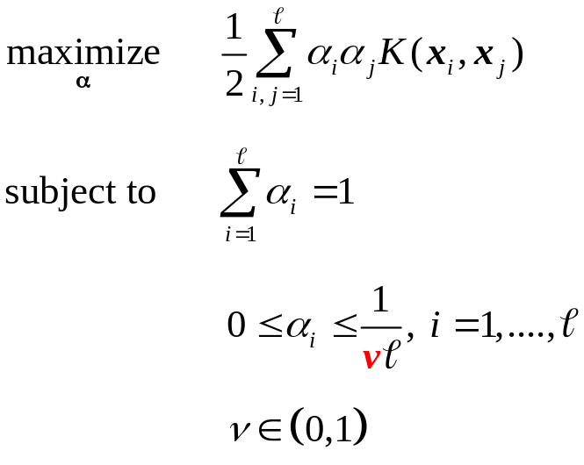
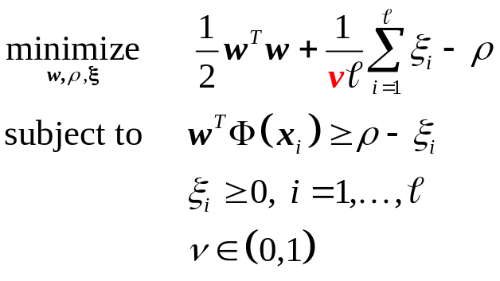
Support Vector Machine (Yun et. al., 2004)
nu(ν)-SVM with 1-class
  separating the data from the origin with maximal margin
  for training data : x₁,…,x_{ℓ} and given parameter ν,
  separating hyperplane h(x):=w^{T}Φ(x)-ρ = 0
  where w and ρ are solved by the following problem:
Lagrange
dual problem

Slide 47


nu(ν)-SVM with 1-class
  ex.) ν≓0 (data which belong to region of h(x)<0 bounded by ν)
h(x) = 0
h(x) > 0
h(x) > 0
h(x) < 0
h(x) < 0
: support vector
<in the input space>
<in the feature space>
Notes:
Its meaning is the upper bound of the ratio of the data number in the outside of pink region to the total data number.
For example, if ν is very small, the optimal separating hyperplane is supporting all data points in the feature space, and capturing all data points in the original input space.
Especially, the data on this boundary have non-zero Lagrangian multiplier, and they are to be the support vectors.
Based on this idea, I would like to propose the method for generating Pareto frontiers.

Slide 48
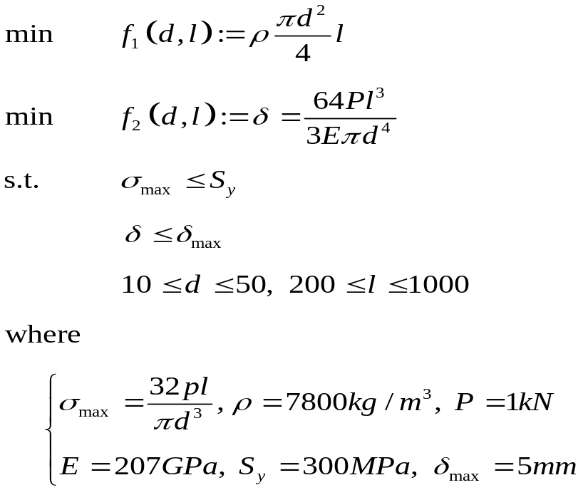
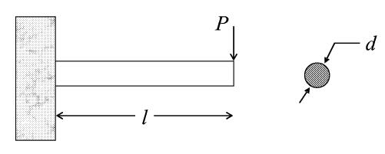
Cantilever Beam Problem
design variables
  diameter d (mm)
  length l (mm)
objective functions
  weight (kg)
  end deflection (mm)
constraints
  maximum stress
  end deflection
* This problem is cited from K. Deb, 2000
Notes:
Next, we consider a cantilever design problem.
As this figure shows, the beam has to carry the end load P.
The cantilever design problem has two conflicting objective of design,
minimizing the weight f₁ and
minimizing the end deflection f₂,
and two constraints,
the developed maximum stress σ_{max} is less than the allowable strength S_{y} and
the end deflection δ is smaller than a specified limit δ_{max}.
With all of the described consideration, the optimization problem is formulated like this for the two design variables, the diameter d and the length l of the beam.

Slide 49
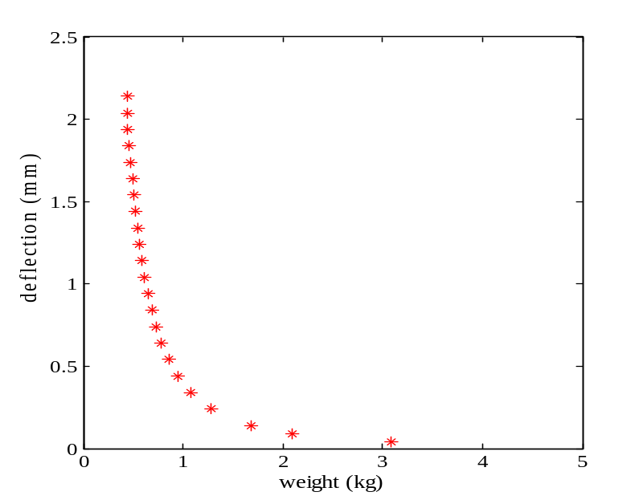
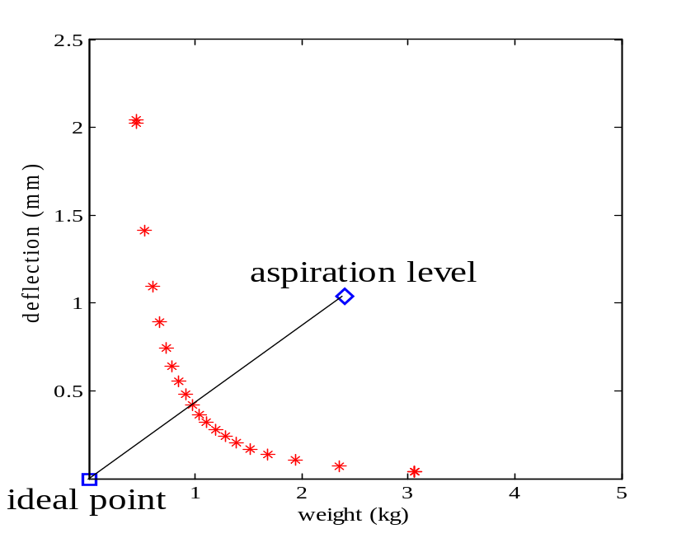

Constraint transformation method
Satisficing trade-off method
It takes about 50 function calls to obtain each Pareto point.

Slide 50
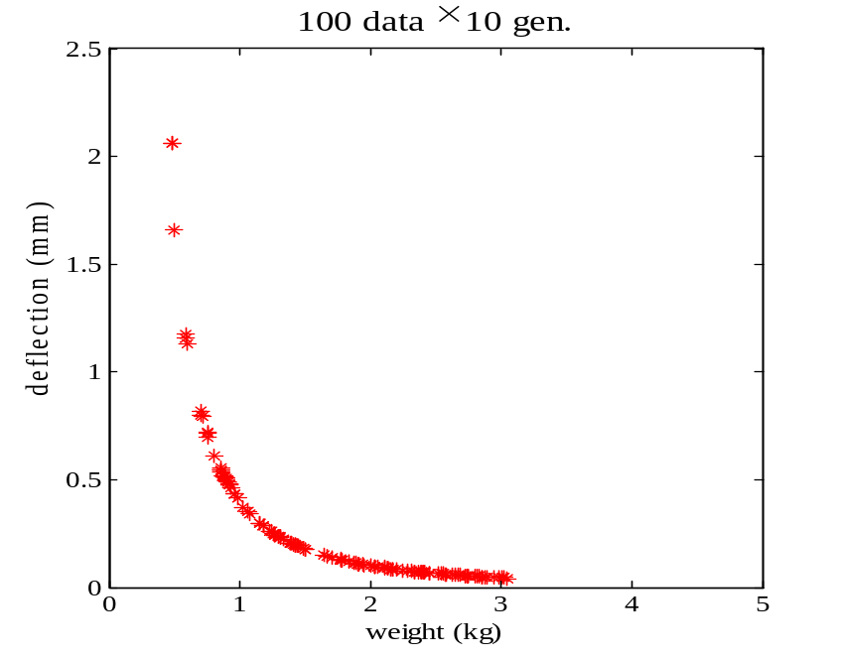
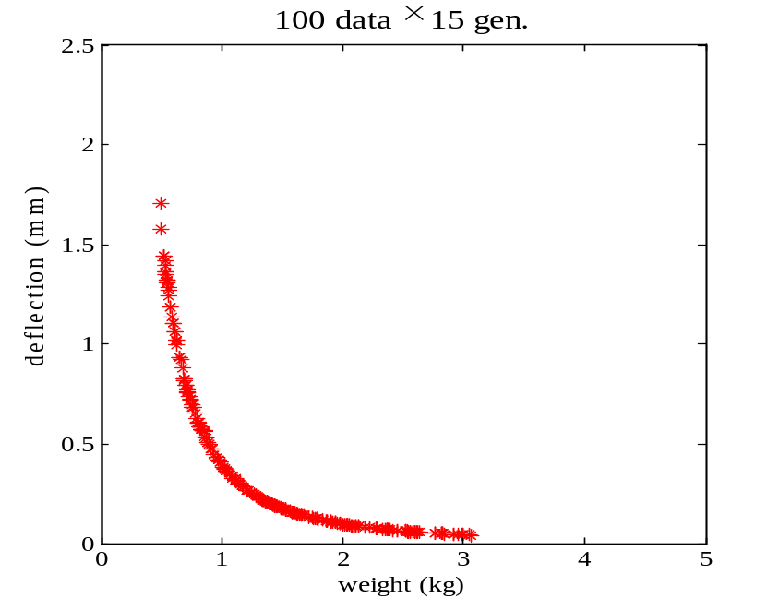
GDEA

Slide 51
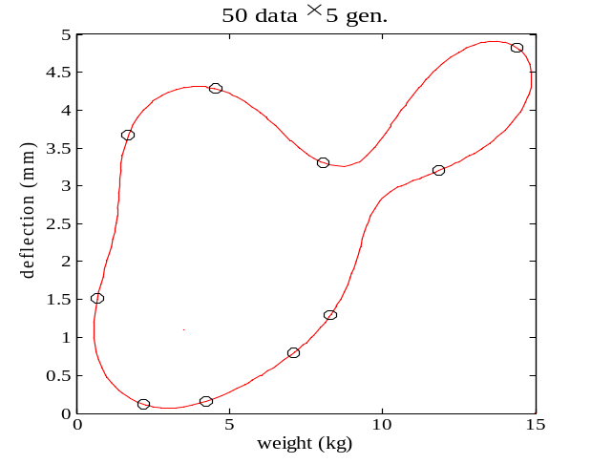
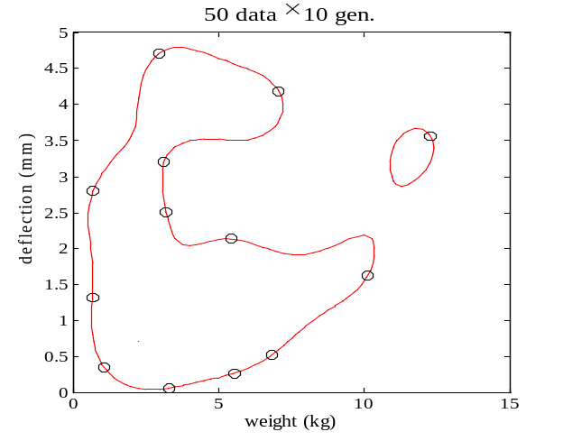
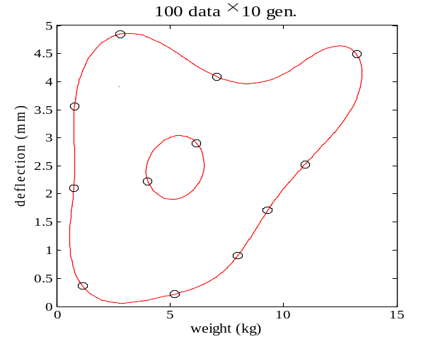
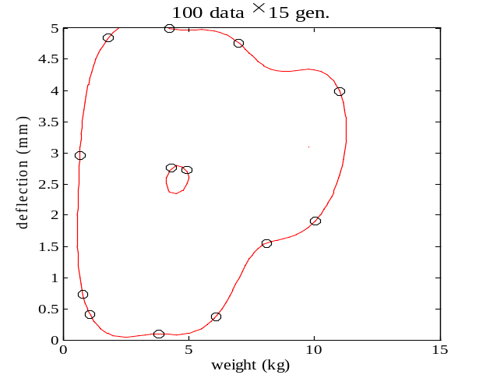
SVM
50data×5gen
50data×10gen
100data×10gen
100data×15gen

Slide 52
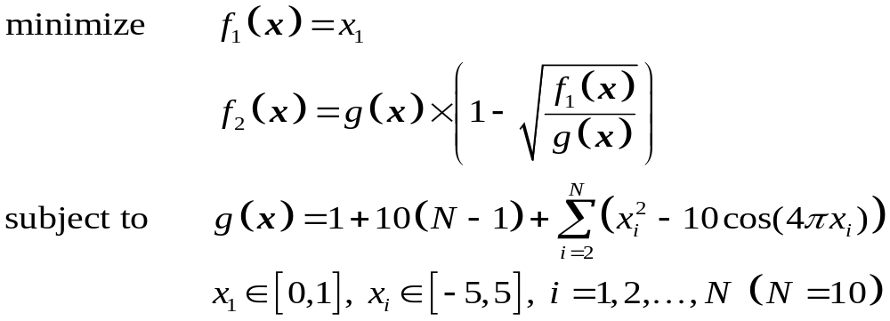
ZDT4
Pareto surface satisfies g=1 (x₂=x₃=…=x₁₀=0).

Slide 53
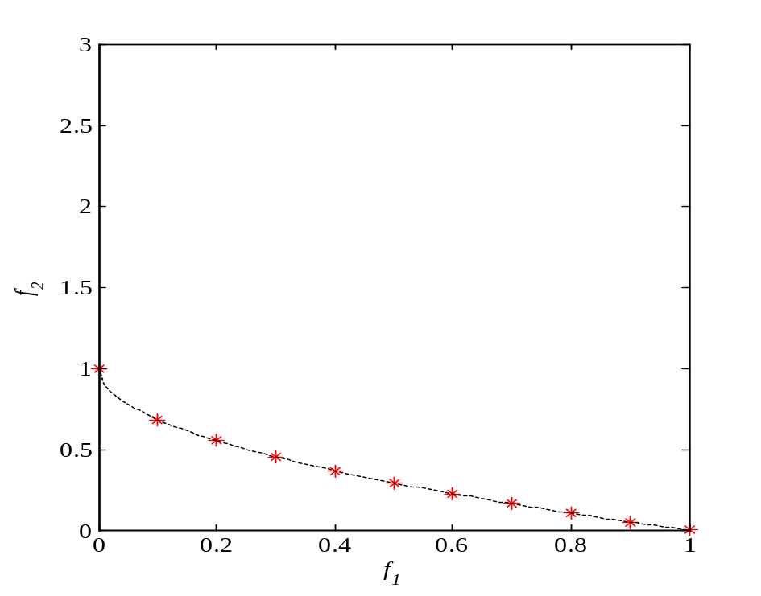
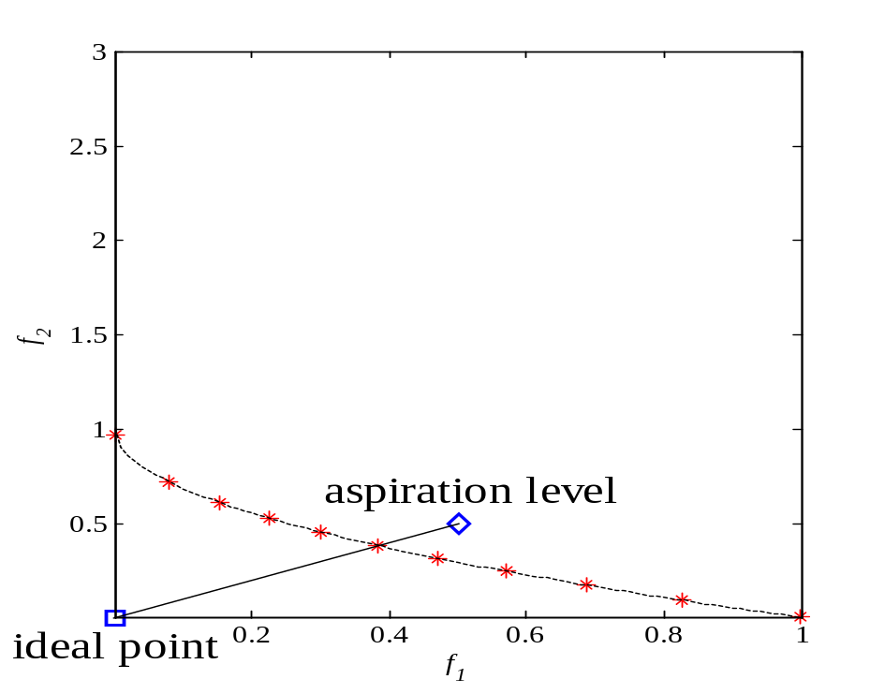
Constraint transformation method
Aspiration level method
It takes about 50 function calls to obtain each Pareto point.

Slide 54
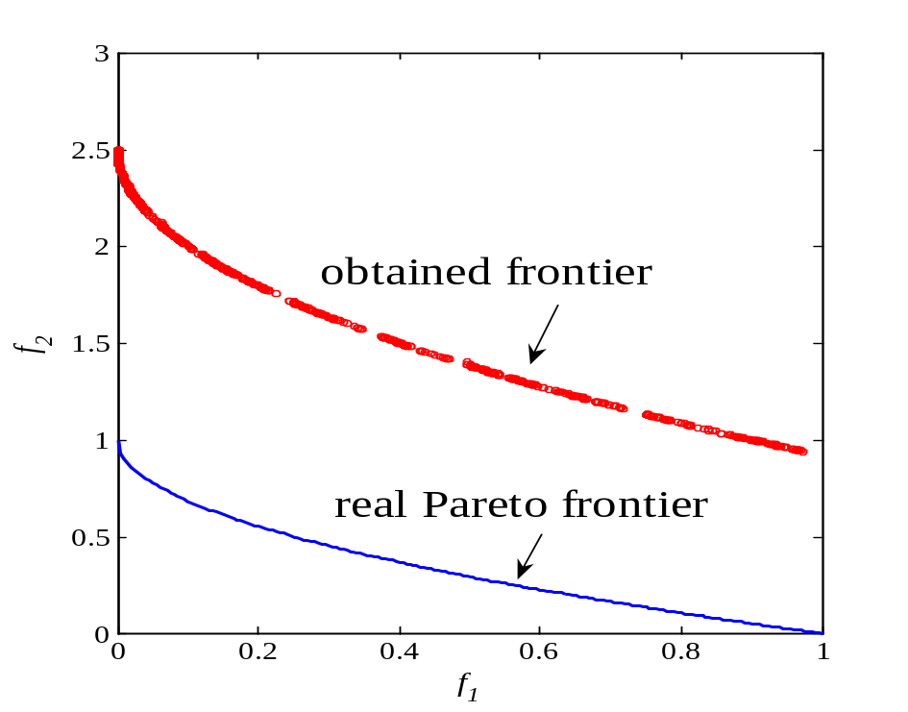
MOGA & GDEA
(100 data×250 gen.)

Slide 55
Concluding Remarks
Aspiration level methods are suitable for cases with many objective functions in which the auxiliary optimization problem is easily solved.
Generation methods of Pareto frontier are suitable for cases with a few objective functions in which the auxiliary optimization problem is not so easily solved (e.g., combinatorial, nonsmooth).
gray zone
Usually, a large number of function calls are needed.

Slide 56
Future Subjects
Parallel computation
Virtual evaluation (Karakasis-Giannakoglou 2004)
(Nakayama-Yun 2005)
function approximation by computational
intelligence
Combining evolutionary methods and interactive methods

Slide 57
Combining aspiration level methods and generation methods of Pareto frontier
Y. Yun, H. Nakayama, M. Arakawa
Multiple Criteria Decision Making with Generalized DEA and an Aspiration Level Method
European Journal of Operational Research，Vol.158，pp. 697-706 (2004)

Slide 58
References
Gal, Stewart, Hanne (eds.):
Multicriteria Decision Making – Advances in MCDM Models, Algorithms, Theroy and Applications, Kluwer 1999
Ehrgott, Gandbleux (eds.):
    Multiple Criteria Optimization – State of the Art Annotated Bibliographic Surveys, Kluwer 2002
=====================================
Sawaragi, Nakayama, Tanino:
Theory of Multi-objective Optimization, Academic Press 1985
中山，谷野: 多目的計画の理論と応用，コロナ社 1994
（Nakayama, Tanino: Theory and Applications of Multi-objective
Programming) in Japanese

Slide 59
International Conference on Optimization Techniques and Applications (ICOTA7)
December 12-15, 2007
Kobe/JAPAN
http://www.iict.konan-u.ac.jp/ICOTA7/

